Slide 1




Practice
Text Network Analysis
Digital Business Ecosystem Research Center

Slide 2

Text Network Analysis
The analysis of text describing various kinds of "computer support solution" that allows the analyst to "extract networks of concepts" from text
The assumption underlying the emergence text network is a relationship that is contained in every word so that it produces a pattern that can be analyzed
Source: Bratawisnu et al., (2017)

Slide 3
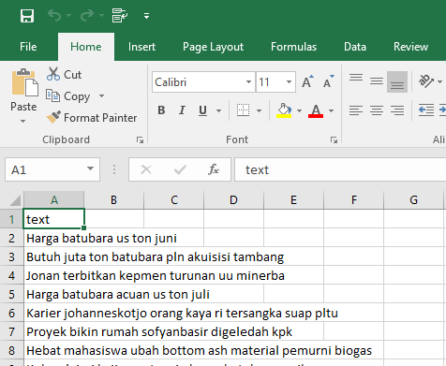
Data Preparation
Prepare the data which consist textual content
Place the textual content in one column
Named the column with “text”, then save file as .csv
*don’t forget to preprocess the data

Slide 4
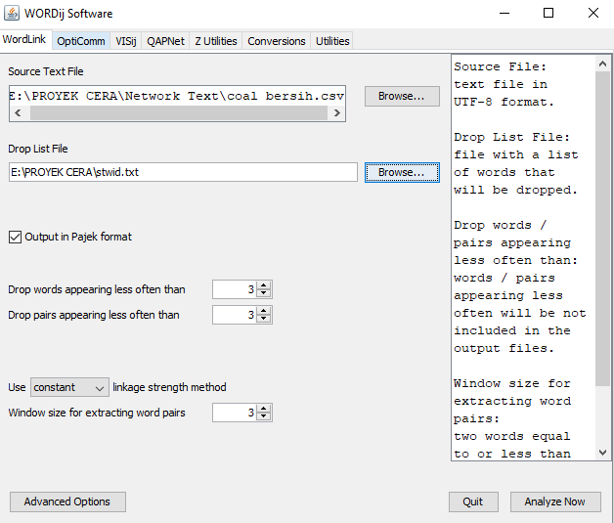
Data Preparation
Open WORDij
On the “Source Text File” click browse > choose the file
On the “Drop List File” click browse > choose file stopwords
Then, click “Analyze Now”

Slide 5
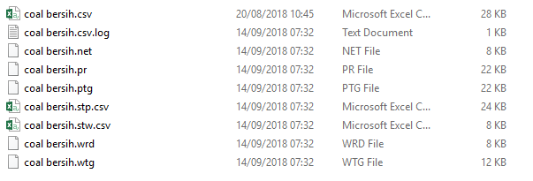
WORDij Output

Slide 6
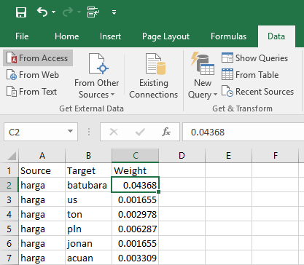
Data Preparation
Create new excel file
Place into column “pair” on the .stp file to the new excel file.
Named the 1st column as “Source” and 2nd column as“Target”
Place the data from“proportion” in .stp file to .xlsx which has column named source and target
Place the data to the 3rd column and named its first row as “Weight”
Save file as .CSV

Slide 7
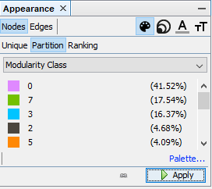
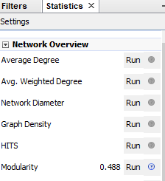
Analyze with Gephi
On overview, choose layout and click run
On statistics toolbar, run “modularity” > Click Ok > finish
On the tab appearances toolbar, click “nodes” > “Partition” > “Modularity Class” > Apply
The modularity network will appear as different color for each groups of network.

Slide 8
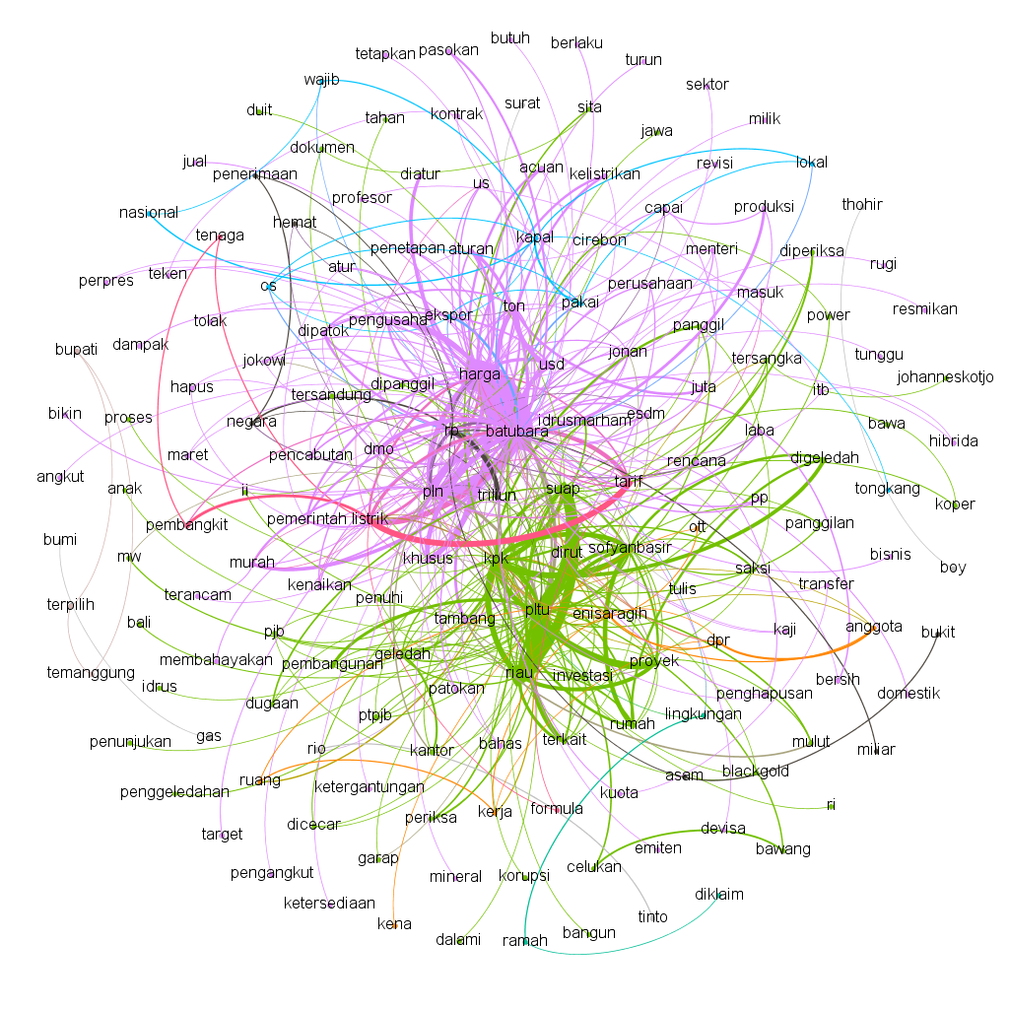
Visualization with Gephi
Go to data laboratory, click “copy data to other column” > choose “id” > copy to “label”.
Go to preview
Click “show labels”
Modify the visualization by the font or the color in the left side.
Click Refresh

Slide 9

THANK YOU

